Slide 1

Unit 03.02.01 CS 5220: COMPUTER COMMUNICATIONS
Packet Switching – Virtual Circuits
XIAOBO ZHOU, Ph.D.
Professor, Department of Computer Science

Slide 2
Packet Switching – Virtual Circuit
Packet
Packet
Packet
Packet
Virtual circuit
Call set-up phase sets ups pointers in fixed path along networks
All packets for a connection follow the same path
Abbreviated header identifies connection on each link
Variable bit rates possible, negotiated during call set-up
Physical-layer circuit vs Network-layer virtual circuit

Slide 3
Connection Setup
Connect request
Connect request
Connect request
SW 1
SW 2
…
SW n
Connect confirm
Connect confirm
Connect confirm
Signaling messages propagate as route is selected
Signaling messages identify connection and setup tables in switches
Typically a connection is identified by a local tag, Virtual Circuit Identifier (VCI)
Each switch only needs to know how to relate an incoming tag in one input to an outgoing tag in the corresponding output
Once tables are setup, packets can flow along path

Slide 4
Virtual Circuit Forwarding Tables
Input
VCI
Output
port
Output
VCI
Each input port of packet switch has a forwarding table
Lookup entry for per-link/port VCI of incoming packet
Determine output port (next hop) and insert VCI for next link
Very high speeds are possible (HW-based)
Table can also include priority or other information about how packet should be treated
12
13
44
15
15
23
27
13
16
58
7
34

Slide 5
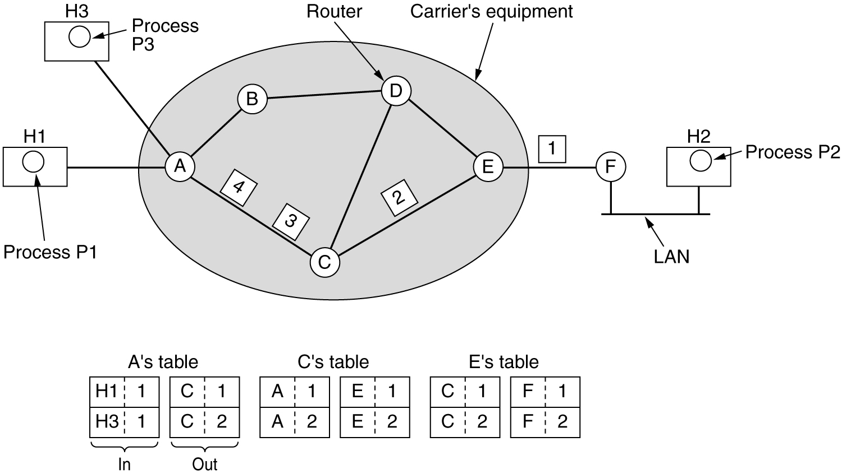
Routing in Virtual Circuit Subnet
Label switching

Slide 6
Virtual Circuit w/ Connection Setup Delay
t
Connect request
1
2
3
CC
t
CR
1
2
3
Release
CC
t
CR
Connect confirm
1
2
3
t
Connection setup delay is incurred before any packet can be transferred
Delay is acceptable for sustained transfer of large number of packets
This delay may be unacceptably high if only a few packets are being transferred

Slide 7
Example: ATM Networks
All information mapped into short fixed-length packets called cells
Connections set up across network
Virtual circuits established across networks
Tables setup at ATM switches
Several types of network services offered
Constant bit rate connections
Variable bit rate connections

Slide 8
Cut-Through Switching
Source
t
Switch 1
1
2
3
t
1
2
3
Switch 2
t
1
2
3
t
Destination
Minimum delay = 3τ + T
Some networks perform error checking on header only, so packets can be forwarded as soon as header is received & processed
Delays reduced further with cut-through switching

Slide 9
Message vs. Packet Minimum Delay
Message switching:
L τ + L T = L τ + (L – 1) T + T
Packet switching with store-and-forward
L τ + L P + (k – 1) P = L τ + (L – 1) P + T
Cut-Through Packet switching (Immediate forwarding after header) = L τ + T
Above measurements neglect header processing delays

Slide 10
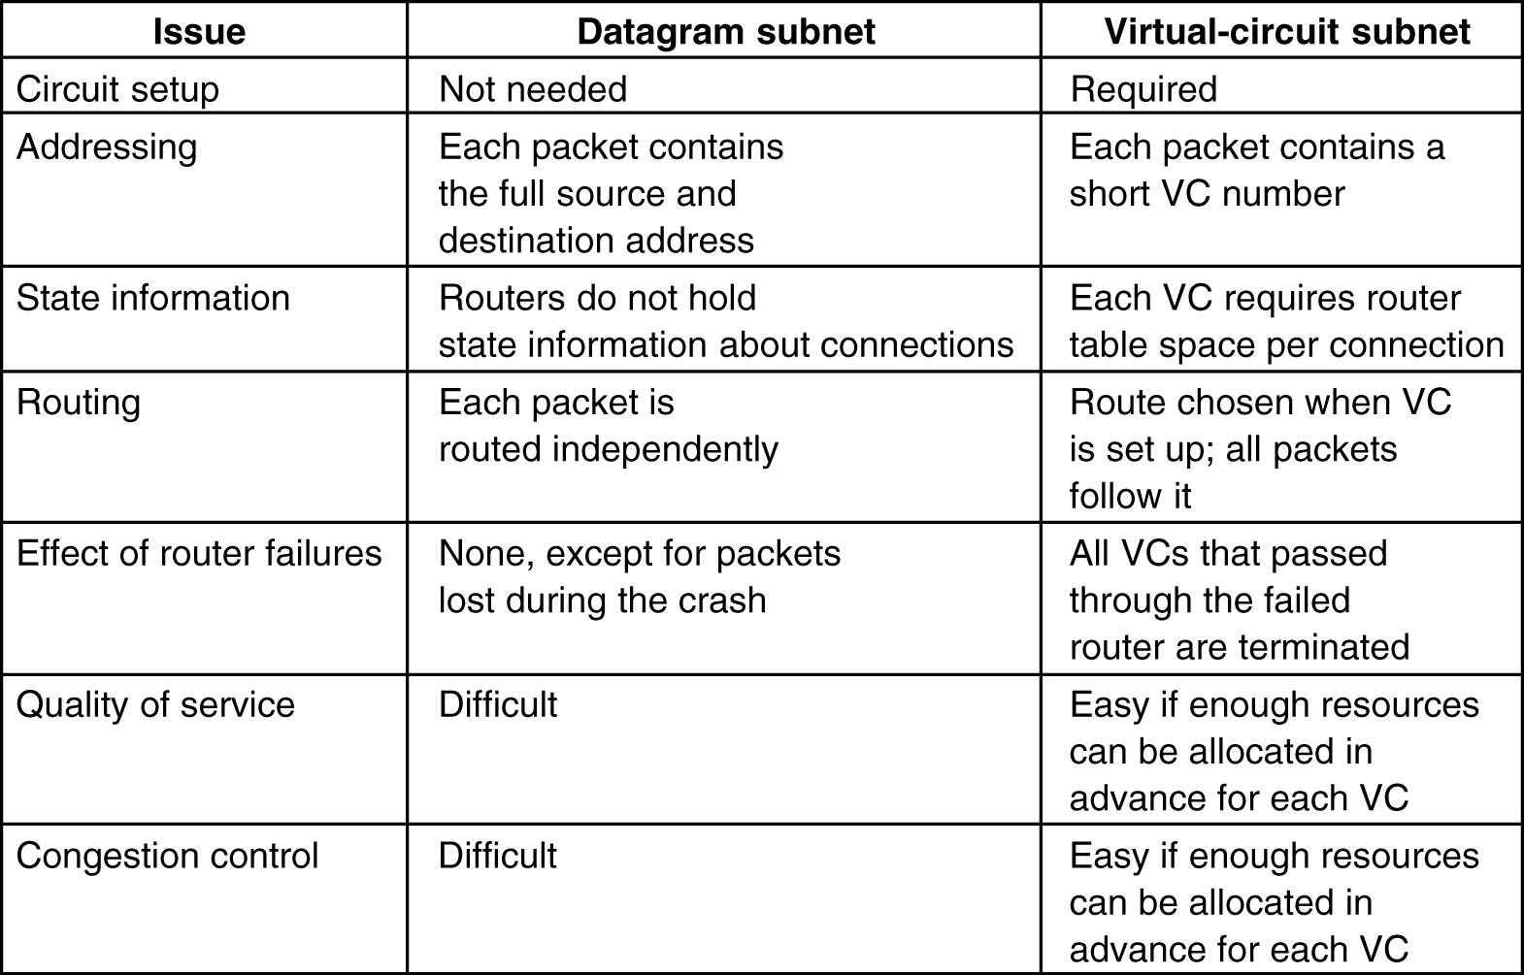
5-4

Slide 11
Unit 03.02.02 CS 5220: COMPUTER COMMUNICATIONS
Routing in Packet Networks
XIAOBO ZHOU, Ph.D.
Professor, Department of Computer Science

Slide 12
Routing in Packet Networks
1
3
6
4
2
Node
(switch or router)
5
Three possible (loopfree) routes from 1 to 6:
1-3-6, 1-4-5-6, 1-2-5-6
Which is “best”?
Min delay? Min hop? Max bandwidth? Min cost?

Slide 13
Routing Algorithm Requirements
Responsiveness to changes
Topology or bandwidth changes, congestion
Rapid convergence of routers to consistent set of routes
Freedom from persistent loops
Optimality
Resource utilization, path length
Robustness
Continues working under high load, congestion, faults, equipment failures, incorrect implementations
Simplicity
Efficient software implementation, reasonable processing load

Slide 14
Creating the Routing Tables
Need information on state of links
Link up/down; congested; delay or other metrics
Need to distribute link state info using a routing protocol
What information is exchanged? How often?
Exchange with neighbors; Broadcast or flood
Need to compute routes based on information
Single metric; multiple metrics
Single route; alternate routes

Slide 15
Routing Tables in Datagram Networks
Destination
Output
address
port
Route determined by table lookup
Routing decision involves finding next hop in route to given destination
Routing table has an entry for each destination specifying output port that leads to next hop
Size of table becomes impractical for very large number of destinations
0785
7
1345
12
1566
6
2458
12
Notes:
(Destination, next hop, cost)

Slide 16
Example: Internet Routing
Internet protocol uses datagram packet switching across networks
Networks are treated as data links
Hosts have two-part IP address:
Network address + Host address
Routers do table lookup on network address
This reduces size of routing table
In addition, network addresses are assigned so that they can also be aggregated

Slide 17
Routing in Virtual-Circuit Packet Networks
1
2
7
1
8
B
3
A
3
6
5
1
5
4
2
VCI
Host
4
3
5
Switch or router
2
C
5
6
D
2
Route determined during connection setup
Tables in switches implement forwarding that realizes selected route

Slide 18
Non-Hierarchical Addresses and Routing
0000 0111 1010 1101
0001 0100 1011 1110
1
4
3
R₁
R₂
2
5
0011 0110 1001 1100
0011 0101 1000 1111
0000 1 0111 1 1010 1 … …
0001 4 0100 4 1011 4 … …
No relationship between addresses & routing proximity
Routing tables require 16 entries each

Slide 19
Hierarchical Addresses and Routing
0000 0001 0010 0011
0100 0101 0110 0111
1
4
3
R₁
R₂
2
5
1000 1001 1010 1011
00 1 01 3 10 2 11 3
00 3 01 4 10 3 11 5
1100 1101 1110 1111
Prefix indicates network where host is attached
Routing tables require 4 entries each

Slide 20
Specialized Routing
Flooding
Useful in starting up network
Useful in propagating information to all nodes
Deflection Routing
Fixed, preset routing procedure
No route synthesis
Notes:
Synthesis: tổng hợp
Không tổng hợp tuyến đường

Slide 21
Flooding
Send a packet to all nodes in a network
No routing tables available
Need to broadcast packet to all nodes (e.g. to propagate link state information)
Approach
Send packet on all ports except one where it arrived
Exponential growth in packet transmissions

Slide 22
1
3
6
4
2
5
Flooding is initiated from Node 1: Hop 1 transmissions

Slide 23
1
3
6
4
2
5
Flooding is initiated from Node 1: Hop 2 transmissions

Slide 24
1
3
6
4
2
5
Flooding is initiated from Node 1: Hop 3 transmissions

Slide 25
Limited Flooding
Time-to-Live field in each packet limits number of hops to certain diameter
Each router adds its ID before flooding; discards repeats
Source puts sequence number in each packet; switches records source address and sequence number and discards repeats

Slide 26
Deflection Routing
Network nodes forward packets to preferred port
If preferred port busy, deflect packet to another port
Works well with regular topologies
Manhattan street network
Rectangular array of nodes
Nodes designated (i,j)
Rows alternate as one-way streets
Columns alternate as one-way avenues
Bufferless operation is possible
Proposed for optical packet networks
All-optical buffering currently not viable

Slide 27
Manhattan Street Network
0,0
0,1
0,2
0,3
Tunnel from last column to first column or vice versa
1,0
1,1
1,2
1,3
2,0
2,1
2,2
2,3
3,0
3,1
3,2
3,3

Slide 28
Summary:
Routing algorithm optimality depends on the objective function that the network operator tries to optimize
Hierarchical addressing reduces the size of routing table
Flooding is useful when routing tables are unavailable

Slide 29
Unit 03.02.03 CS 5220: COMPUTER COMMUNICATIONS
Shortest Path Routing – Distance Vector
XIAOBO ZHOU, Ph.D.
Professor, Department of Computer Science

Slide 30
Shortest Paths & Routing
Many possible paths connect any given source and to any given destination
Routing involves the selection of the path to be used to accomplish a given transfer
Typically it is possible to attach a cost or distance to a link connecting two nodes
Routing can then be posed as a shortest path problem

Slide 31
Routing Metrics
Means for measuring desirability of a path
Path Length = sum of costs or distances
Possible metrics
Hop count: rough measure of resources used
Reliability: link availability; BER
Delay: sum of delays along path; complex & dynamic
Bandwidth: “available capacity” in a path
Load: Link & router utilization along path
Cost: $$$
Notes:
Số liệu định tuyến

Slide 32
Shortest Path Approaches
Distance Vector Protocols
Neighbors exchange list of distances to destinations
Best next-hop determined for each destination
Bellman-Ford (distributed) shortest path algorithm
Link State Protocols
Link state information flooded to all routers
Routers have complete topology information
Shortest path (& hence next hop) calculated
Dijkstra (centralized) shortest path algorithm

Slide 33
Distance Vector Do you know the way to San Jose?
San Jose 294
San Jose 392
San Jose 250
San Jose 596

Slide 34
Distance Vector
Table Synthesis
Neighbors exchange table entries
Determine current best next hop
Inform neighbors
Periodically
After changes
Local Signpost
Direction
Distance
Routing Table
For each destination list:
Next Node
Distance
dest
next
dist

Slide 35
Shortest Path to SJ
Focus on how nodes find their shortest path to a given destination node, i.e. SJ
San
Jose
D_{j}
C_{ij}
j
i
If D_{i} is the shortest distance to SJ from i
and if j is a neighbor on the shortest path, then D_{i} = C_{ij} + D_{j}
D_{i}

Slide 36
But we don’t know the shortest paths
Router i only has local info
from neighbors
San
Jose
D_{j'}
j'
C_{ij'}
D_{j}
C_{ij}
j
i
D_{i}
C_{ij”}
Pick current
shortest path
j"
D_{j"}

Slide 37
How Distance Vector Works
San
Jose
1 Hop
From SJ
2 Hops
From SJ
3 Hops
From SJ

Slide 38
How Distance Vector Works
SJ sends
accurate info
San
Jose
1 Hop
From SJ
2 Hops
From SJ
3 Hops
From SJ

Slide 39
How Distance Vector Works
San
Jose
1 Hop
From SJ
2 Hops
From SJ
3 Hops
From SJ
Hop-1 nodes
calculate current
(next hop, dist), &
send to neighbors

Slide 40
Jack Dark
1 Hop
From SJ
2 Hops
From SJ
3 Hops
From SJ
Current info about SJ
ripples across network,
Shortest Path Converges

Slide 41
Bellman-Ford Algorithm
Consider computations for one destination d
Initialization
Each node table has 1 row for destination d
Distance of node d to itself is zero: D_{d}=0
Distance of other node j to d is infinite: D_{j}=∝, for j≠ d
Next hop node n_{j} = -1 to indicate not yet defined for j ≠ d
Send Step
Send new distance vector to immediate neighbors across local link
Receive Step
At node j, find the next hop that gives the minimum distance to d,
Min_{j} { C_{ij} + D_{j} }
Replace old (n_{j}, D_{j}(d)) by new (n_{j}*, D_{j}*(d)) if new next node or distance
Go to send step

Slide 42
Iteration | Node 1 | Node 2 | Node 3 | Node 4 | Node 5
Initial | (-1, ∞) | (-1, ∞) | (-1, ∞) | (-1, ∞) | (-1, ∞)
1
2
3
Table entry
@ node 1
for dest SJ
Table entry
@ node 3
for dest SJ
2
3
1
1
5
2
San
Jose
4
3
1
3
6
2
4
5
2

Slide 43
Iteration | Node 1 | Node 2 | Node 3 | Node 4 | Node 5
Initial | (-1, ∞) | (-1, ∞) | (-1, ∞) | (-1, ∞) | (-1, ∞)
1 | (-1, ∞) | (-1, ∞) | (6,1) | (-1, ∞) | (6,2)
2
3
D₃=D₆+1
n₃=6
1
D₆=0
2
3
1
1
5
2
0
4
San
Jose
3
1
3
6
2
4
5
2
2
D₅=D₆+2
n₅=6
D₆=0

Slide 44
Iteration | Node 1 | Node 2 | Node 3 | Node 4 | Node 5
Initial | (-1, ∞) | (-1, ∞) | (-1, ∞) | (-1, ∞) | (-1, ∞)
1 | (-1, ∞) | (-1, ∞) | (6, 1) | (-1, ∞) | (6,2)
2 | (3,3) | (5,6) | (6, 1) | (3,3) | (6,2)
3
3
1
2
3
1
1
5
3
2
0
4
San
Jose
3
1
3
6
2
4
5
2
6
2

Slide 45
Iteration | Node 1 | Node 2 | Node 3 | Node 4 | Node 5
Initial | (-1, ∞) | (-1, ∞) | (-1, ∞) | (-1, ∞) | (-1, ∞)
1 | (-1, ∞) | (-1, ∞) | (6, 1) | (-1, ∞) | (6,2)
2 | (3,3) | (5,6) | (6, 1) | (3,3) | (6,2)
3 | (3,3) | (4,4) | (6, 1) | (3,3) | (6,2)
1
3
2
3
1
1
5
3
2
0
4
San
Jose
3
1
3
6
2
5
2
4
6
4
2

Slide 46
Summary: Shortest-Path Tree
1
3
2
3
1
1
5
3
2
0
4
San
Jose
1
3
6
2
5
2
6
2

